Slide 1
Conformed to His Image
By Kenneth Boa

Slide 2
Introduction
Many different approaches to spirituality.
Each one believes theirs is the best available.
There are no quick-fixes and one-size-fits-all
Purpose of text is to explore benefits of Christian spirituality.
We “press on toward the goal. . . Of the upward call” to Christ. (Ph 3:14)
Goals:
  Deepen appreciation for each person’s uniqueness
  Get out of spiritual rut
  Desire to find new paths for our spiritual journey
  Develop greater passion for Christ and desire to know him more
His purpose is that be become “conformed to his image” (Ro 8;29)
Spiritual life is a with God rather than to him.
  We do not make the journey alone.

Slide 3
Spirituality - being concerned with the human spirit or soul as opposed to material or physical things.
Religion vs spirituality
  Religion is a specific set of organized beliefs and practices, usually shared by a community or group. Spirituality is more of an individual practice and has to do with having a sense of peace and purpose.
Postmodern world
  Skeptical about truth – objective truth vs absolute truth
Syncretism – effort to blend different religions and practices
  Results in developing own truth and beliefs based on what the individual wants and likes
All faiths, religions, spiritualties seek to answer the same basic questions:
  Who am I? Where did I come from?
  What is my purpose in life? What happens after death?

Slide 4
People fail to discern the difference between the ‘spirit of truth and the spirit of error’ (1 Jn 4:6)
Christian spirituality is lifelong response to God’s interaction with those who trust the person and work of Jesus Christ.

Slide 5
12 Facets of Spirituality (as per the text)
Facet – one side of a many-sided object
- a particular aspect or feature of something
Each side is only part of the whole – each works together to make the whole
Relational spirituality
Paradigm spirituality
Disciplined spiritualty
Exchanged life spirituality
Motivated spirituality
Devotional spirituality
Holistic spirituality
Process spirituality
Spirit-filled spirituality
Warfare spirituality
Nurturing spirituality Corporate spirituality

Slide 6
Unity in Diversity
We are all in different places on our spiritual journey
We are shaped by our past experiences with people and with God.
But we all need one another.
Different places, different practices – we are growing together
  Developing (growing) our spiritual life with the help of other like ourselves.

Slide 7
RELATIONAL SPIRITUALITY

Slide 8
Loving God Completely
Chapter 1
God is a relational being and created us in his image. Therefore, we are relational beings. We desire relationships with others and with God.
Relating to God deepens our understanding of his causeless, measureless, and ceaseless love.
God wants his relationship with us to grow
We were created to know, love, enjoy, and honor God
Our past experiences with love shape and influence how we come to trust and love God.

Slide 9
Psalm 8 speaks about the glory of God and man’s relationship with him.
God’s glory and power causes us to recognize our own smallness compared to him and the universe he created.
What is man that you take thought of him and care about him? (vs 4)
Man is nothing, but God chooses to love and care for us.
As we grow in our relationship with Christ, we understand more of his causeless (Ro 5:6), measureless (vs 7-8), and ceaseless (vs 9-11) love.
There is nothing we can do to cause God to love us more, and nothing we can do to cause God to love us less.
God wants us to know him, love him, and follow him more closely.

Slide 10
Loving Ourselves Correctly
Chapter 2
What defines you?
Who defines you?
What does it mean to see ourselves as God sees us?
God sees us in our sin and our need for redemption (rescue). He sees us in need of a relationship with him. To make this possible, he offers us forgiveness and grace.
Who does God say that I am? (pgs 36-4 in text)
What are similarities and differences in how you see yourself and how Go sees you?

Slide 11
Loving Others Compassionately
Chapter 3
We are created for an intimate relationship with God who loves us.
God initiated the relationship through creation and his death of the cross.
We love him because he first loved us.
Loving God completely leads to us loving ourselves correctly, and then to loving others with compassion.
God’s love for us and our love for him liberate us from using people to meet our needs.

Slide 12
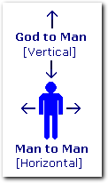
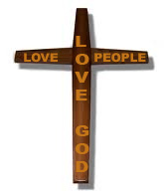

Slide 13


Slide 14
Our faith is demonstrated through our choices and works of love to other people.
What is true greatness?
  Jesus demonstrate greatness in John 13 when he was wiling to serve his discriples rather than being served.
We need to know God’s and our own
  Dignity and power
  Significance and identify
  Security and destiny

Slide 15
Jesus know who he was and whose he was.
He understood his relationship with God and with others.
In Christ we find our
  Dignity and power (Ephesians 1.3 & 19; 3.16 & 20-21)
  Significance and identity (Romans 8.16; 1 John 3.1-2)
  Security and destiny (Romans 8.18 & 35-39
When these truths begin to define our self-image, they make us secure enough to love and serve others without putting our own interests first.
We have nothing to prove because we know who and whose we are.
We become more concerned with what God thinks than about what others think.

Slide 16
Society and culture tells us we must accomplish and impress.
We serve the idol of accomplishment
  Activities
  Achievements
“Everyone ought to fear to die until he has done something that will last forever.”
It is not a tragedy to die for something you believe in, but it is a tragedy to find at the end of your life that what you believed in betrayed you.
Living a life loving, serving, and being compassionate to others results in no regrets at the end of our lives.

Slide 17
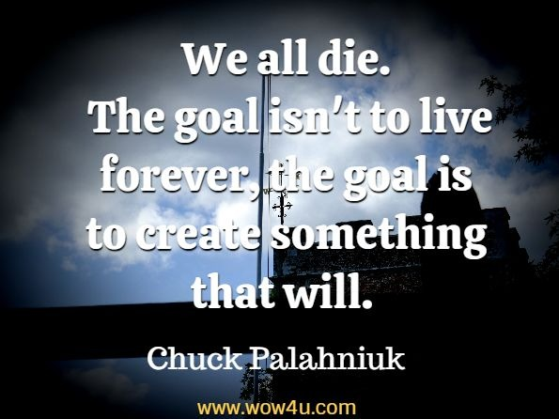
Our best legacy will what we did for others and how we treated them.

Slide 18
Five Kinds of People
(text pg 48)
Resourceful people
Important people
Trainable people
Nice people
Draining people
The first three groups is where we want to live
How do you treat difficult people in your life?

Slide 19
God offers us the gift of forgiveness
(text pg 50-51)
We have been forgiven by God and so can offer forgiveness to others.
What does forgiveness mean?
Forgiveness does not mean forgetting.
Forgiveness is to release others from any obligation to make up to you what they have taken from you.
Forgiveness means we are releasing the right to resentment and leave justice with God.

Slide 20
Paradigm Spirituality

Slide 21
Life is a Journey, but
Where are You Going?
Chapter 4
We need to develop a balance of biblical realism about the present and hope for the future.
Our life on earth is brief. Our hope should not be based in the temporary things of this life, but in the future with God.
Realizing our mortality should cause us to treasure the opportunities of each moment and day.
Temporal – relating to worldly rather than spiritual (secular)
Eternal – lasting or existing for all time; truths and values that are unchanging

Slide 22
If you found out you had only one year to live, how would it affect . . .
your vision of life?
your role on this earth?
the way you invest your time?
If there is a significant distance between your life now and how it would be altered, then you are likely living with a temporal view of life rather than an eternal view.

Slide 23
Dominant World Views
Ultimate reality is material and everything in the universe is an impersonal product of time and chance. (annihilation)
Ultimate reality is not material but spiritual. (But spiritual does not mean God or other personal spiritual agent. (reincarnation)
Ultimate reality is infinite, intelligent, and a personal being (God).
The third view offers hope beyond the grave.
Christians and Scripture teaches resurrection into eternal life.
God never builds a staircase that leads to nowhere.

Slide 24
Need for Paradigm Shift
Paradigm – perspective based on prescribed set of rules
Paradigm shift – when the rules and boundaries change our perspective is altered
Temporal and eternal are two perspectives. – two ways of viewing life.
If we see life primarily from a temporal perspective, we need a paradigm shift to the biblical perspective.
Making a paradigm shift involves a great risk.
The biblical paradigm challenges most everything that our culture reinforces.
We must desire to pursue the tings that will last rather than things that will will not for eternity or even this life.

Slide 25
Carpe diem! – seize the day (moment)
Make the most of life; live to the fullest; have no regrets
People usually do not grasp this truth until mid-life. However, the earlier we get it, the more productive and giving our lives can be.
We have limitations, but God has none.
James 4.4 – friend of world, enemy of God
Luke 16.15 – what is highly thought of by man is detestable to God
Care for your body as if it will live forever; care for your soul as it will dies tomorrow (Augustine).

Slide 26
What are the most important things in life to you?
What would you change if had opportunity to live life again?
reflect more risk more do more things that will last
Matt 6:26 - What good will it be for someone to gain the whole world, yet forfeit their soul? Or what can anyone give in exchange for their soul?
(Mark 8:36; Luke 9:25)

Slide 27
Young Man by Billy Dean
When I'm just an old man on a front porch in a chair
Rocking with the memories from my past
The lines you see on my face should tell a tale of no regrets
I want to look forward to looking back on the race I ran
When I was a young man.

Slide 28
Creating and leaving a legacy
Support the People and Causes That are Important to You
Reflect and Decide What is Most Important in Your Life
Share Your Blessings With Others
Be a Mentor to Others
Pursue Your Passions Because They Are Infectious
Pass along your values. (time, family, work, money, faith. . . )
Practice outrageous generosity.
Live with character, conviction, and passion. he most indelible legacy is the way that we live.
Be honest. Nothing communicates like authenticity.
Ground your purpose in a greater purpose. Live a life with God’s purpose clearly in view.
Live for others.

Slide 29
Imagine your funeral
Who would give a eulogy at your funeral?
What will they miss about you?
What positive attributes will they associate you with?
How are they describing you?

Slide 30
Identify the legacy you wish to leave
What do you want your life to stand for?
How do you want to be remembered by your family and friends?
What will those beyond your circle of family and friends remember you for?
What kind of an impact do you want to have on your community?
How will the world be a better place because you were in it?
What contributions do you want to make to your field?
Whose lives will you have touched?
What lessons would you like to pass on to future generations?
What do you want to leave behind?
How can you serve?
How will share your faith in God and a Christian lifestyle?

Slide 31
Quotes about Legacies
“Carve your name on hearts, not tombstones. A legacy is etched into the minds of others and the stories they share about you.” —Shannon L. Alder
“If you would not be forgotten as soon as you are dead, either write something worth reading or do something worth writing.” —Benjamin Franklin
“That is your legacy on this Earth when you leave this Earth: how many hearts you touched.” —Patti Davis
“The great use of life is to spend it for something that will outlast it.” —William James
“Your story is the greatest legacy that you will leave to your friends. It’s the longest-lasting legacy you will leave to your heirs.” —Steve Saint

Slide 32
“We all die. The goal isn’t to live forever, the goal is to create something that will.” ~ Chuck Palahniuk
“While it is well enough to leave footprints on the sands of time, it is even more important to make sure they point in a commendable direction.” ~ James Cabell
“Our days are numbered. One of the primary goals in our lives should be to prepare for our last day. The legacy we leave is not just in our possessions, but in the quality of our lives. What preparations should we be making now? The greatest waste in all of our earth, which cannot be recycled or reclaimed, is our waste of the time that God has given us each day.” ― Billy Graham
“A writer doesn’t dream of riches and fame, though those things are nice. A true writer longs to leave behind a piece of themselves, something that withstands the test of time and is passed down for generations.” ~ C.K. Webb
What will you legacy be? What will live on after you’re gone?

Slide 33
What will you be known for when you leave this earth? The most influential people, the ones who leave behind incredible legacies, will live on in the hearts of the people they touch. Physically, they will no longer be a part of society—but their principles, love for God, godly lifestyle, philosophies and achievements will become immortal, spreading from generation to generation.
You can start making your mark on the world today.

Slide 34
Can We Trust God?
Chapter 5
Temporal value system vs eternal value system
Prosperity knits a man to the world. He finds his place in it. (Lewis)
But you, are you seeking great things for yourself? Do not seek them. (Jeremiah 45.5)

Slide 35
Temporal Eternal
Pleasure
Recognition of people
Popularity
Wealth and status
Power
Leads to . . .
Emptiness
Delusion
Foolishness
Knowing God
Approval of God
Servanthood
Integrity and Character
Humility
Leads to. . .
Fulfillment
Reality
Wisdom

Slide 36
What the non-negotiables in your life?
What the non-negotiables of your faith?
Some non-negotiables of Christian faith . . .
Life is about God and not about us.
We exist to serve God not to persuade God to serve us.
We were created by the Creator, so our highest purpose to to grow in knowledge of him and become more like him.
The Bible is inspired by God, so we should desire to learn, understand, experience, and apply its truth.
The truth of Scripture is countercultural. We are torn toward the temporal and away from the eternal.

Slide 37
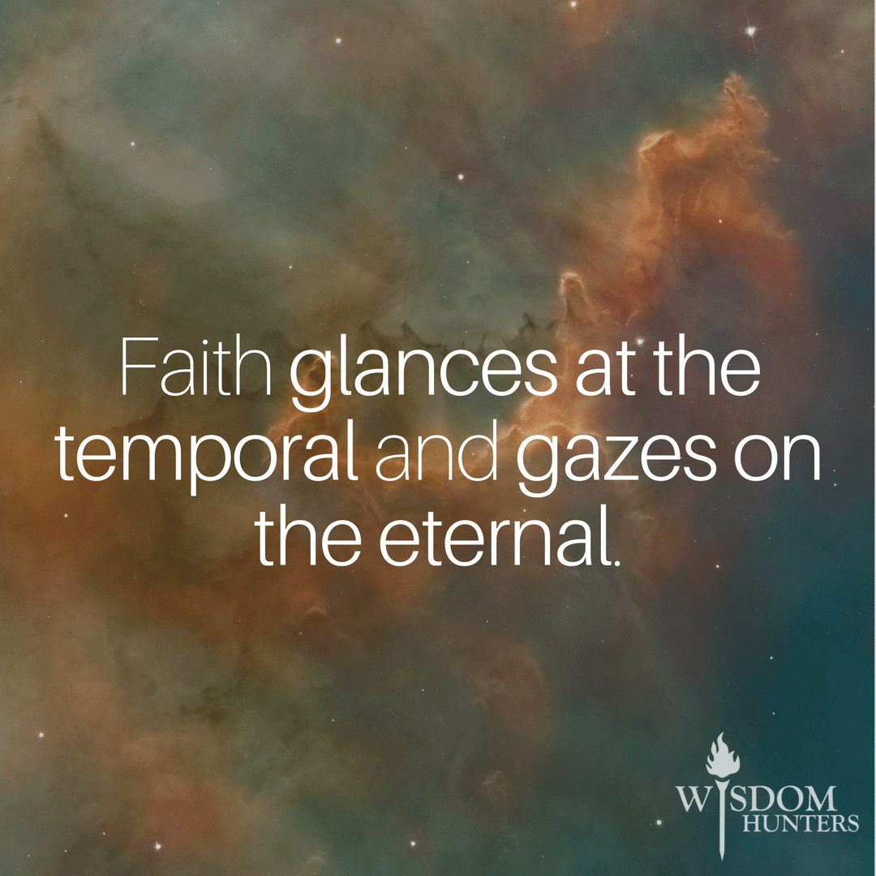
Let temporal things serve their use, but let eternal things be the object of your desire. (A Kempis)
2 Corinthians 4.16-18
Matt 6.33 and 6.19-24
Luke 15.1-15
Luke 10.17-24

Slide 38
Chapter 6 – 7
Spiritual Disciplines
Discipline – area of study or a practice in which we engage on a regular business
Spiritual disciplines aid in spiritual growth
There are many spiritual disciplines – the most basic being
prayer Scripture reading fasting worship
Spiritual disciplines are grouped – inward, outward, corporate
Inward – meditation, prayer, fasting, study
Outward – simplicity, solitude, submission, service
Corporate – confession, worship, guidance, celebration

Slide 39
Spiritual Disciplines include:
Solitude and Silence
Prayer
Journaling
Study & Meditation
Fasting & Chastity
Secrecy
Confession
Fellowship
Submission & Guidance
Simplicity, Stewardship (giving), Sacrifice
Worship & Celebration
Service
Witness

Slide 40
Chapter 8
Our Identity in Christ
Our new identify in Christ can transform us
Do I see a need to be transformed?
Spiritual life is not doing things for Jesus but allowing Christ to work in and through us.
Our God-given needs:
love & acceptance
significance and identity
competence & fulfillment

Slide 41
Spiritual Life
IS NOT | IS
Crisis | Continual Process
Knowledge | Obedience
External | Internal
Automatic | Cultivated
Self-energized (accomplished) | Divinely enabled
Dream | Discipline
List of rules | Life of Relationship
Endured | Enjoyed
Theoretical | Practical

Slide 42
10 Principles
1. My self-life is exchanged for Christ’s life.
2. Identity with his death, burial, resurrection, and ascension
means our old life has been exchanged for the life of Christ.
3. Who does God say I am? (refer to chapter 3)
4. Must now truths & by faith acknowledge them to be true (Ro 8.6-13)
5. Basis of salvation is also basis of sanctification
6. Parts of the process:
brokenness, realizing my lack of resources and efforts, unconditional surrender
7. Christ lives his life in and through us (Jn 15.1-8)
8. Truths must move from my head to my heart (Eph 1.17-19)
9. Spiritual life is inside-out not outside-in (Eph 1.17-19 & Phil 2.12-13)
10. Not trying to do things for Jesus but realizing and believing what he has already done (Gal 2.20 & 2 Co 5.17)
Notes:
3. Who does God say I am?
Ro 15.7
Ro 8.17 heir
John 1.12 child of God
John 15.15 friend of Jesus
Ro 6.6 no longer a slave to sin
2 Co 5.17 new creature
Eph 1.4 & Col 3.12 chosen, holy, beloved, blameless before Christ
Ro 8.2 free from law of sin & death
Ro 6.14 no longer under law but grace

Slide 43
You Say by Lauren Daigle
(find the song online to listen)
I keep fighting voices in my mind that say I'm not enough
Every single lie that tells me I will never measure up
Am I more than just the sum of every high and every low
Remind me once again just who I am because I need to know
Ooh-oh
You say I am loved when I can't feel a thing
You say I am strong when I think I am weak
And you say I am held when I am falling short
And when I don't belong, oh You say I am Yours
And I believe (I)
Oh, I believe (I)
What You say of me (I)
I believe

Slide 44
The only thing that matters now is everything You think of me
In You I find my worth, in You I find my identity
Ooh-oh
You say I am loved when I can't feel a thing
You say I am strong when I think I am weak
And you say I am held when I am falling short
When I don't belong, oh You say I am Yours
And I believe (I)
Oh, I believe (I)
What You say of me (I)
Oh, I believe

Slide 45
Taking all I have, and now I'm laying it at Your feet
You have every failure, God, You have every victory
Ooh-oh
You say I am loved when I can't feel a thing
You say I am strong when I think I am weak
You say I am held when I am falling short
When I don't belong, oh You say I am Yours
And I believe (I)
Oh, I believe (I)
What You say of me (I)
I believe
Oh, I believe (I)
Yes, I believe (I)
What You say of me (I)
I believe

Slide 46
Chapter 9
Identity with Christ in his crucifixion and resurrection means our old life has been exchanged for the life of Christ.
Identity with Christ moves us from works of grace and legalism to liberty
because Christ’s life is our life.

Slide 47
Devotional Apps
YouVersion
Bible Gateway
Blueletter Bible
D365
Idisciple
Crosswalk
Bible.com
He/She reads Truth
Daily Bible App
Specific Person

Slide 48
Chapter 13
Our Image of God
Restoring (Correcting) Distorted Images and Misunderstanding of God

Slide 49
Instructions for Today:
Open the Populi assignment to respond to today’s questions. Questions you should answer will be in yellow. After you write your answers, we’ll discuss them together as a class.

Slide 50
Being Misunderstood
What is one thing about you that people often misunderstand?

Slide 51
A distorted image of God is simply a belief in a lie that can keep us from trusting or from stepping out in faith on God’s promises.

Slide 52
Distorted images often come from. . .
imperfect relationships
viewing God as a controller rather than a leader
Satan’s desire to keep us from God
authority figures
religious training
experiences

Slide 53
Misunderstanding God
1st Corinthians 2:14 says, “But people who aren’t spiritual can’t receive these truths from God’s Spirit. It all sounds foolish to them and they can’t understand it, for only those who are spiritual can understand what the Spirit means.”
God is misunderstood because we don’t try to see things from His perspective.

Slide 54
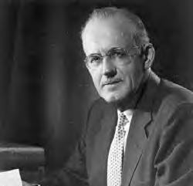
A.W. Tozer said this:
“What comes into our minds when we think about God is the most important thing about us.”

Slide 55
Question for Reflection
What comes to your mind when you think about God?

Slide 56
Question for Reflection
Would you have answered that question differently in years past? If so, what changed?

Slide 57
Common Misconceptions about God – David G. Newby
God is mad at you.
God doesn’t love you.
God doesn’t want to help you.
God doesn’t want you to have fun.
God wants to zap you with lightning for being bad.
God doesn’t allow you to mess up and make mistakes.
God doesn’t like people who aren’t perfect or super religious.
God will forgive anything, so I can do whatever I want.
Can you relate to any of the common misconceptions about God? If so, which ones?

Slide 58
What are some of the lies?
God who . . . VS | God who . . .
Has impossible expectations | Is compassionate
Is emotionally distant | Has empathy & grace
Is inattentive | Is intimate
Is unreliable | Is trustworthy
Abandons | Pursues
Withholds | Provides
Is weak | God who . . .

Slide 59
While you may not be able to control every thought that comes into your mind, there is a difference between passively giving in to the default position of society and actively following the disciplined practice of training your mind.

Slide 60
Romans 12:2 (NLT)
Don’t copy the behavior and customs of this world, but let God transform you into a new person by changing the way you think. Then you will learn to know God’s will for you, which is good and pleasing and perfect.

Slide 61
Inside your mind. . .
We will become transformed to what we most love and admire…
What is your first reaction to the above sentence?

Slide 62
If our heart’s desire is fixed on something society says is good, it becomes like an idol to us and can corrupt us.
The opposite is also true.
When we focus on what God wants for our lives, we become more like Him, and we reflect His image as we were originally created to do!

Slide 63
What are the top five things that compete for your time, attention or
admiration?
Now evaluate . . .
Are they good things?
Are they things that have temporal or eternal value?

Slide 64
We are shaped by our aspirations and transformed by our pursuits and intentions.
“What do you want more
than anything else?”

Slide 65
Our aspirations, pursuits and intentions should put letting God lead our lives first and then allow every other pursuit, dream and goal flow from it.
Adjusting our view of God can start with consciously putting him first in all we do (Matthew 6:33), and doing what we do for him rather than ourselves ( I Corinthians 10:31).
Remember from Monday…

Slide 66
A.W. Tozer said:
“What comes into our minds when we think about God is the most important thing about us.”
Do you consider God trustworthy?
Why or why not?

Slide 67
What are the consequences of a less-than-accurate understanding of who God is?

Slide 68
We are faced with a few choices:
Will we know God as society thinks we should know God, or will we know Him the way He wants us to know him?
Will we commit our mind and heart to knowing God correctly or will we allow just anyone and anything to influence how we think?
Spending time with God is the only way to know God.

Slide 69
Can you think of a time in which your initial understanding of Christianity changed as you gave it more thought and learned more? If so, what was it? What happened?

Slide 70
During our discussions this week, what changes (adjustments) do you realize you need to make in the way you think about or understand God?

Slide 71
Chapter 16
Growing in Love with God
Open the assignment in Populi corresponding to Chapter 16 (slide 71).
Questions for reflection and answer are written in yellow.

Slide 72
Learning from the Prodigal Son
Actions and Attitudes
Read Luke 15:11-32 – the story of the lost (prodigal son)
Make some observations about the actions and attitudes of the oldest son, the father, and the youngest son. Use the chart on the next slide.

Slide 73
 | Oldest Son | Father | Youngest Son
Actions
Attitudes

Slide 74
Which attitude in the story can you closely identify with?
Which attitude in the story is hardest for you to identify with?
What do the actions and attitude of the father reveal about God’s actions and attitude?

Slide 75
Be Thankful
God’s gifts to each person are many. One way to grow in our love for God is to learn to be thankful people.
Make a list of the gifts God has given you using the following categories:
Tangible blessings –
Spiritual blessings –
Relational blessings –
Thankfulness should be on our lips all day and especially as part of our prayer time and conversation with God.

Slide 76
Enemies to Our Devotion to God
Disobedience
Complacency
Neglect of spiritual disciplines
Conformity to rules just because it is a rule
Knowing about God more than knowing Him
Putting service and ministry actions above Christ
Commitment to an institution (i.e. church or organization) more than to Christ
Interest in God for what he can do for me

Slide 77
Which of these enemies do you see active in your spiritual life?

Slide 78
In John 15:1-11 Jesus talks about a vine that bears fruit – like a grapevine.
Read the passage.

Slide 79
What are the results of a branch that abides in (stays connected to) the vine?
What causes the production of fruit in this metaphor?
How dos the metaphor apply to our growth in Christ?
How does the metaphor of the vine and branches help us guard against the enemies that would try to sabotage our spiritual devotion?

Slide 80

1. Learn about him
2. spend time together
3. Keep thinking about him
4. Talk to him
5. Recognize his voice
6. Sing to him
7. Defend him

Slide 81
Some more ways. . .
Get rid of lesser loves
I Kings 3:3 talks about King Solomon also having misplaced affections in his life. It says, “Solomon showed his love for the Lord by walking according to the instructions given him by his father David, except that he offered sacrifices and burned incense on the high places.”
Understand the love he has for you
I John 4:19 says “we love Him, because He first loved us.“
Know him personally – have a personal relationship with him
Ephesians 2:10 – For we are what he has made us, created in Christ Jesus for good works, which God prepared before hand to be our way of life.

Slide 82
Spend time in his word
Stay in love with him
Falling in love with God is the best decision you will ever make in your life.
Tell him you love him

Slide 83
Choose to do everything out of love for him
1 Corinthians 10:31 - Whether therefore ye eat, or drink, or whatsoever you do, do all to the glory of God.
Spend time with other people who love God
This is why attending church is important. It helps us stay connected to other believers. We encourage one another and help each other grow spiritually.
Jeremiah 29:13 - “if you seek me, you will find me, when you seek me with all your heart.” We must seek him and keep on seeking Him.

Slide 84
Which of the 15 ways to fall in love with God
would you like to begin to practice?
What is your plan for making it happen?
When will you start?

Slide 85
The Integrated Life
Chapter 18 & 19
1 Corinthians 10:31 –
Whether you eat or drink or whatever you do,
do it to the glory of God.

Slide 86
The difference between 11:00 on Sunday morning and 11:00 on Monday morning can be enormous.
Why?
What makes the difference?

Slide 87
What does integrated mean?
What do you think it means that our lives should be integrated?

Slide 88
An integrated life means
doing all things for the glory of God
brining our ‘sacred’ and ‘secular’ life together
What do we mean by a sacred and secular life?
We usually view life as compartmentalized – secular and sacred
church/God/religion and the other things in my life
Failing to view life as an integrated whole instead of a compartmentalized view can lead to discrepancies between belief and behavior
remember – 11:00 on Sunday and Monday

Slide 89
Do you think the above statement is true? Why?
Give two specific examples of how you see compartmentalization in your life.

Slide 90
Qualities and Habits
Considering your life as a whole (every part of your life), list five qualities you do exhibit in your life ow and five practices you would like to make part of your daily/weekly routine.
Present Qualities | Desired Practices/Quaities

Slide 91
Which of these qualities and habits are instantaneously gained?
What current priorities, habits, goals, etc. are preventing you from acquiring the items on your list?
Small degrees of faithfulness can shape our lives over time.
God is our strength and can help us through the Holy Spirit to pursue our desired qualities and habits.

Slide 92
Brother Lawrence was a French monk in the 17th Century. He was committed to doing “little things for the love of God, who regards not the greatness of the work, but the love with which it is performed.” Brother Lawrence spent his adult life in a monastery. His daily task? Washing dishes.
We can have the same attitude if we think about giving every task to God as we begin doing it. “I am going to do this in Jesus’ name. Thank you allowing me have the opportunity to do it.” (or some like prayer)

Slide 93
What activities can you do in Jesus name and thank him for it?
Taking out the trash
Doing the dishes
Cooking a meal
Studying (completing assignments)
Attending class
Practice time
Playing time on the court or field

Slide 94
Incarnational Living
What is incarnational living?
Most of us have never even heard of it before.
Think about Jesus being born – we say he was incarnated
meaning what was divine became human
Incarnational living means recognizing the spiritual significance in every situation.
It means being conscious of Jesus’ presence in every situation and activity of our lives.

Slide 95
One way to begin practicing incarnational living is to practice sentence prayers before, during, and/or after our daily activities
Pray for someone during a conversation
Thank God when paying a bill
Thank God for food each day
Thank God for clothing as you dress
Pray at work for wisdom and excellence in doing your job
Pray for understanding when sitting in class and before doing class assignments

Slide 96
Name five situations you normally engage in during day.
What sentence prayer can you pray in each of those situations?

Slide 97
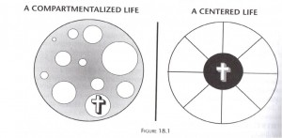

Slide 98
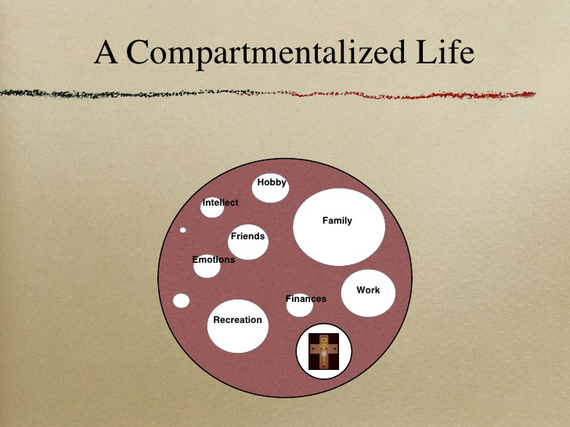

Slide 99
Draw a similar circle (or heart) including the specific areas (compartments) of your life .

Slide 100
There is a difference between religion and actually knowing and having a relationship with God.
Religion - a system of beliefs and expectations adherents follow
Knowing God – having a personal relationship with God
It is the difference between knowing about God and doing all the ‘right’ things prescribed by our faith community (church) and truly knowing God and desiring to live according to his Word.
Which is part of your life, a religious commitment or a personal relationship with God.

Slide 101
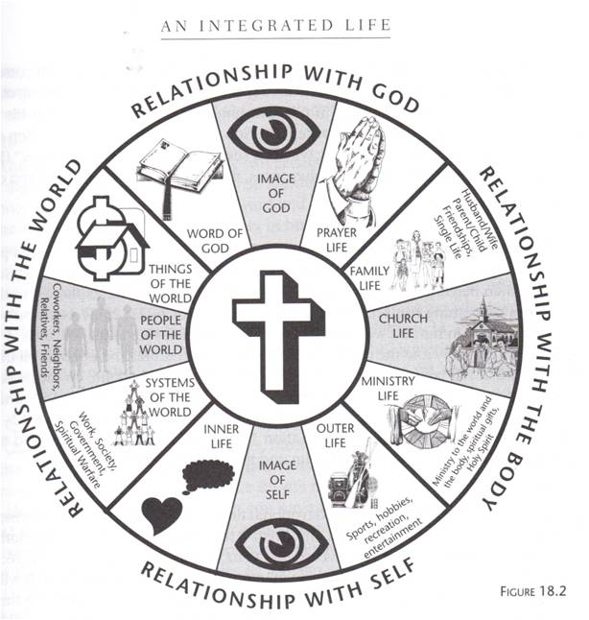

Slide 102
Remember the discussion of horizontal and vertical relationships??
Vertical – between you and God
Horizontal – between you and others
In the diagram on the previous slide, notice that the top and bottom quadrants are relationships in the vertical aspect of our lives.
The left and right quadrants are our relationships in the horizontal perspective

Slide 103
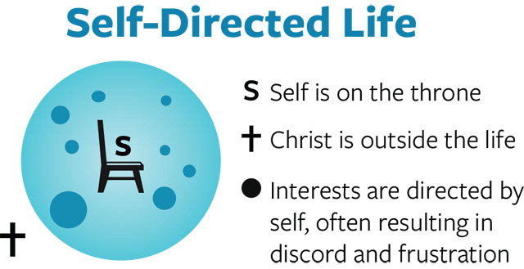
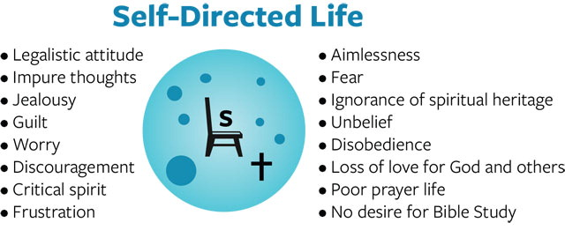

Slide 104
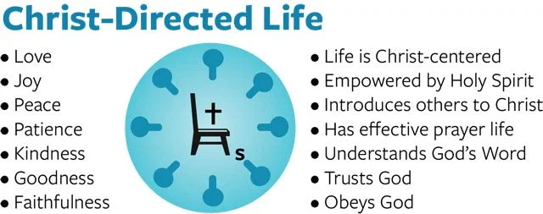

Slide 105


Slide 106
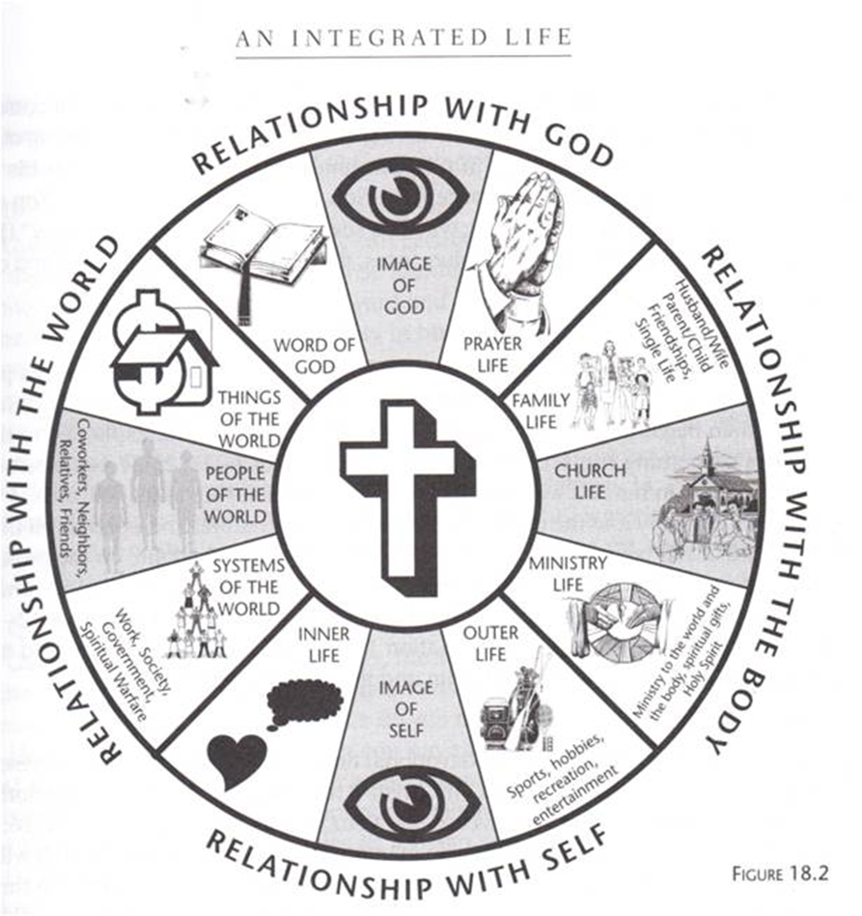
Are there areas of your life where you are certain that God is in control?
What areas do you need to take yourself off the throne of your life and allow God to be in control?
If you put Christ at the center of your life, what changes would you need to make?
Are you willing to make those changes? Why?

Slide 107
An Undivided Heart
Single-minded pursuit of God
Many times our hearts are very divided.
We can truly be seeking to live a Christ-centered life, but still there are times when divided loyalties tempt us.
If we are not seeking to live a Christ-centered life, there are always times when your heart and mind think about ‘what if I gave him my life.’
Psalm 63:1 Psalm 42:1-2
Philippians 3:10 – I want to know Christ. . .

Slide 108
What does it mean to have an undivided or single-minded heart?
In what areas of your life is there a need for rebalancing in order to have a single-minded focus on God?

Slide 109
Temptations that distract and create loss of focus
Materialism
Thinking we have a better understanding of what is best for us than God does.
Unconvinced that obedience to God in all things is worthwhile.
Spiritual anemia – forget what God has done for us in the past
(his intervention in our lives and answered prayers)
Desire for recognition from others (more than desire for recognition of God).
We are more concerned with the opinions of others than with pleasing God.
John 5:44
Are there others distractions to add to the list?

Slide 110
Which of these temptations or others speak most
clearly to your life?
How can you move forward in the Philippians 3:10 pursuit?

Slide 111
How often do you find yourself trying to play by two sets of rules?
What are the different sets of rules you try to live by?

Slide 112
Relationships, work, society, personal goals are crucial to our spiritual growth and to our witness to people who are watching us. We must learn to integrate our faith into each of the areas (compartments) of our lives.
Relationships
Marriage
Parent/Child
Friendships
Self

Slide 113
Work
To integrate our faith into our working life, we must begin to look through a new lens that sees work differently than the way society looks at work
We generally think that work is a part of life that allows us to earn money so we can pay bills, have entertainment, provide a place to live, food to eat, and clothes to wear. It is often viewed as a necessary part of life that we would not do if given choices.
However, as believers, we must take scripture seriously and seek to serve God rather than ourselves through our work.
Our work is often at the center of our circle rather than God.

Slide 114
Why is it so easy for work to become the center of our lives?
What can you do to guard against making work the center of your life?
How can a proper perspective on work help us. . .
Bring glory to God
Serve others
Give generously
Express gratitude

Slide 115
Developing a Christian work ethic
I Thessalonians 4:11-12, 5:14 2 Thessalonians 3: 6-9 & 10-15 Colossians 3:17 & 23
Proverbs 6:6-11, 10:4, 12:11, 13:11, 14:23, 16:3, 18.9, 20:13, 21:5 & 25, 24:30-31, 28:19
Ecclesiastes 3:22, 9:10
1 Corinthians 10:31
Ephesians 4:28
Ps 127:2, 128:2
Luke 6:31
Galatians 6:7-9
I Timothy 6:6-10
Romans 12:11

Slide 116
Work vs Rest
God created us to have a place for both work and rest in our lives. Keeping a healthy balance between the two is crucial. When we overwork and ignore the principles of rest, our life soon becomes out of balance, and every area of our life is effected – relationships, mental and physical health, spiritual health.
Why do people so often place more emphasis on work
than on other areas of their lives?

Slide 117
Some reasons for overworking. . .
Greed
Lack of trust in God’s provision
Mismanagement of time
Failure to prioritize events and relationships in our lives
Arrogance/Pride

Slide 118
Philippians 2:14-16
⁴ Do everything without grumbling or arguing, ¹⁵ so that you may become blameless and pure, “children of God without fault in a warped and crooked generation.”^{[a]} Then you will shine among them like stars in the sky ¹⁶ as you hold firmly to the word of life. And then I will be able to boast on the day of Christ that I did not run or labor in vain.

Slide 119
School and Sport
Another area of concern for our lives is our studies and sports.
Studies are important to our future but need our focus and priority now – even though the results of what we do now may be in the long term (graduation and after) rather than today and tomorrow.
Sport and good health is important to God. Scripture often uses sport as an illustration of the Christian life.
1 Corinthians 9:24-27 Hebrews 12:1, 11 Isaiah 40:29-31
Psalm 18:29 2 Timothy 2:5, 4:7 Deuteronomy 31:6
Colossians 3:23-24 Philippians 2:3-4 1 Timothy 4:8

Slide 120
Why do many students not prioritize their studies
(class attendance and assignments)?
What distractions do students allow to interfere with their studies?
What distractions keep you from prioritizing your studies on your daily agenda?

Slide 121
What strategies can students use in prioritizing their studies?
rethink and realign daily agenda
keep a daily and monthly calendar
be faithful to your schedule
learn to say no to impromptu activities
remind yourself why you studying and why it is important
What other strategies would you add to the list?

Slide 122

Sport
Sports are an important part of our college years.
Do not think of them separately apart form your studies.
Both studies and sports are a part of your life in these years – keep a balance
As you make your daily, weekly, and monthly schedules, sports (practice time and games) should be part of your agenda.
The same strategies used to prioritize your studies should be used for your sport involvement also.
Maintain a balance between study time and sports. Without a balance and proper prioritizing, failure in one area or the other will surely happen.

Slide 123
The first step in reordering your life, prioritizing, and setting agendas is to see the need for this to happen. Without determination to change and improve your daily schedule, nothing will change.
You must want change bad enough to make it happen.
Remember: change starts with you, not with your friends, teachers, coaches, etc.

Slide 124
Reflect honestly on your life and how well you do or do not organize and prioritize your life.
1. Make a list of the things that occupy most of your days –
like classes, work, study times, practice time, etc.
2. How well do you balance these activities each day?
3. Which items get more or less attention than others?
4. What can you do in the remainder of the semester to create a better balance for the activities in your life? (be specific)

Slide 125
In conclusion. . .
Now think about all we have talked about – compartmentalizing our lives, putting God at the center of all we do, intentionally bringing God into our relationships, our work, our studies and sport.
Pulling together answers to several of the questions you have answered in this unit,
1. write a brief summary of where you see your life now in the areas listed in the statement above.
2. Specifically, how (or where) do you want to see changes in your life in the months ahead?
3. What are you going to do today to begin implementing the changes?
4. How will you incorporate God into your plans?

Slide 126
Holistic Living
Chapter 20
I Corinthians 4:2
Now a person who is put in charge as a manager must be faithful.

Slide 127
Management Responsibilities –
Make a list of everything you can think of that you are responsible for.

Slide 128
Review the list and ask yourself this question:
Am I as faithful to each of my responsibilities as I could or should be?

Slide 129
Holistic Spirituality is a practical approach to living as a Christian that says this:
I will put God first.
I will put family second.
I will put work/responsibility/calling (everything else) third.

Slide 130
Because I choose to put God first, I also trust God to take care of my family, my work, my calling, my responsibilities as I am faithful to Him and my day to day responsibilities.
Key takeaway: God will help you be faithful to all your responsibilities.

Slide 131
Mindset toward stewardship of all my life. . .
I own nothing.
I am not on this earth to carry out my own business.
Philippian 3:8-11
Our purpose in life is to. . .
Love God completely
Love myself correctly
Love others compassionately

Slide 132
As a manager, how does the holistic
approach to life help you evaluate and carry
out your life’s purpose?
(Philippians 3:8-11)

Slide 133
All that I have belongs to God. He has given the physical, mental, and material provision to have ‘things.’
Godly stewardship says that I use the things I have for the glory of God, remembering to whom they really belong.

Slide 134
Managing your Time
Ephesians 5:15-16 (NLT):
“So be careful how you live. Don’t live like fools, but like those who are wise. Make the most of every opportunity in these evil days.”
Psalm 31:14-15
Psalm 90:12
Romans 13:11-12
2 Corinthians 4:18

Slide 135
“I didn’t have enough time” is an excuse we’ve all made.
When you use this excuse, what does it convey about how you? What are you saying about yourself?

Slide 136
What are the top two areas in which you could use your time more wisely?
What would be the positive results?

Slide 137
What improvement could you make to your time management skills that would give immediate results?

Slide 138
Managing your Talents
1 Peter 4:10
“Each of you should use whatever gift you have received to serve others, as faithful stewards of God’s grace in its various forms.”
What is a steward?

Slide 139
How can we be good managers of our talents and skills?

Slide 140
Managing your Treasure (Resources)
The Bible mentions money or material possessions more than 2,300 times.
What does this emphasis tell you about the
importance of the topic?

Slide 141
What does this emphasis tell you about our nature and inclinations as humans?
Do you struggle with stewardship of treasure?

Slide 142
Deuteronomy 8:17-28
Job 1:1-3
Psalm 24:1
Psalm 50:10-11
Matthew 6:19-21
1 Timothy 6:6-10
1 John 3:17

Slide 143
Managing Truth
Luke 8:18 (NIV)
Take care how you listen; for whoever has, to him more shall be given; and whoever does not have, even what he thinks he has shall be taken away from him.

Slide 144
Truthfulness is important to God and is one of the defining ways we give a Christian witness.
Zechariah 8:14-17
James 4:5-8
James 5:12 (Matthew 5:37)
Psalm 52:2-4
Psalm 15:2-3
Ephesians 4:25
Philippians 4.8 . Whatever is . . . Think (and speak) these things.

Slide 145
What areas of our lives require truthfulness?
words
actions – making words and actions match
thoughts

Slide 146
Truthfulness in our lives is seen in our integrity and responsibility.
Honest, responsible people are generally truthful to themselves and to others.
Truthfulness is not only a matter of what we say or do that others can see.
Truthfulness resides within us and is then seen in what we do and say.

Slide 147
In what areas of your life do you find it hard to be truthful?
Starting today, what can you do to be a more truthful person?

Slide 148
Managing Relationships
What mistakes do you often see people make in caring for relationships?

Slide 149
What does God expect from us in caring for our relationships with one another?
>>
>>
>>

Slide 150
Job 42:10
Luke 16:9
Colossians 4:5
3 John 5-8

Slide 151
Is there a relationship in your life that you are not managing well?
What can you do to help make the relationship better?

Slide 152
Managing Emotions
What does it mean to manage our emotions?
What are indications that we are not managing our emotions?
Is it possible to manage our emotions 100% of the time?
What is Emotional Intelligence?

Slide 153
We should _____________ our emotions rather than allowing our emotions to ______________ us.
In what emotional areas to do you need to exercise more control over your emotions (demonstrate more emotional intelligence).

Slide 154
Process vs Product
Chapter 21
Matthew 6:34
Do not worry about tomorrow; for tomorrow will care for itself. Each day has enough trouble of its own.

Slide 155


World vs Word (God’s word)

Slide 156

These images show what we have previously discussed – us at the center of our lives or God.
Is it all about me or about
how I relate to God and
serve others?

Slide 157
World – achievement and activity define who you are
Word – Christ defines who you are and is the basis for all we do

Slide 158
Not every journey through life is pleasant.
Every life has steps of the journey that involve –
uncertainty
setbacks
disappointment
surprises
joy
grief
pain (emotional & physical)

Slide 159
What are the differences in how each approach would handle worry?
How would each approach handle setbacks?
How would each approach influence your thoughts about establishing a legacy?

Slide 160
How do these passage help equip us for the difficult steps of our life journey?
Romans 5:3-5
2 Corinthians 4:16-18
Ephesians 2:19-22
James 1:1-5
1 Peter 4:12-16

Slide 161
What do these passages teach us about comparing our journey to the journey of others?
John 21:18-22
2 Corinthians 10:12-18

Slide 162
How does a mindset of comparison and impatience hinder you in loving others as you love yourself?

Slide 163
What does Hebrews 5:11-14 teach us about how we ought to be growing in our life journey?

Slide 164
Faith, Hope, and Love
Faith, hope, and love characterize our life in Christ.
They teach us how we view –
the past – faith in God’s redemptive work
the future – hope in our eternity with Christ
the present – love of Christ shown to others
The past and future are unseen and invisible, but they greatly impact how we live in the present.

Slide 165
Faith – involves knowledge, trust, and action
God has created us with different dispositions. Some of us tend toward knowledge, others toward trust, and others toward action.
Do you find yourself drawn to one of these areas more than to the others?
Why do you think that is true?

Slide 166
In what area do you tend to feel weak
or to avoid?
How can you strengthen that area as part of your spiritual growth process?

Slide 167
2 Thessalonians 2:15-17 gives us strength in our knowledge, trust, and action
Stand firm and hold to the traditions which you were taught, whether by word of mouth or by letter from us.
Now may our Lord Jesus Christ himself and God our Father, who has loved us and given us eternal comfort and good hope by grace, comfort and strengthen your hearts in every good work and word.

Slide 168
As we journey through life, we need to be alive to the present moment(s) but still looking hopefully toward the future. Our hope in the future then gives our present meaning.
How does hope for the future affect. . .
your present attitude?
your present ambitions (goals)?
your present actions?

Slide 169
Hebrews 6:18-19
. . . we who have taken refuge [in Christ] have strong encouragement to take hold of the hope set before us. This hope we have an anchor of the soul, a hope both sure and steadfast. . .

Slide 170
Faith, hope, and love – Paul says the greatest of these is love (1 Corinthians 13:13).
One reason that love is greatest is because of its impact on all of our life (past, present, future).

Slide 171
Consider 1 Thessalonians 1:2-3
We give thanks to God always for all of you, making mention of you in our prayers; constantly bearing in mind your work of faith and labor of love and steadfastness of hope in our Lord Jesus Christ in the presence of our God and Father.
What are some implications of living out this verse in your life?

Slide 172
Popular concepts of love as the world teaches are often passive and emotional. For example, we say that someone ‘falls in love’ or that love is a feeling in response to something or someone.
How does Paul's description of love differ from passive and emotional concepts?
Work in faith
Labor in love
Remain steadfast in hope

Slide 173
Being vs Doing
Chapter 22
Being (busyness) is a tyrant of the majority of our adult lives.
Busyness blurs the borders between the varied aspects of our daily living.
We stuff our schedules full of activities and neglect to rest.
This leaves us exhausted and feeling empty and without time to nourish our spiritual lives.
Busyness generally has to do with five categories of our lives:
home work recreation ministry spiritual life (relationship with God)

Slide 174
Inventory your activities (television, social media, screen time, sports, academics, etc.). What area (s) is getting too much time? What areas not enough time?
Remember: balance in all of life is important.
How can you give less time to some things and more time to others to bring more balance
to your life?

Slide 175
Does your present life style allow you quality time for. . .
spiritual development
family
sport
academics
involvement in church?

Slide 176
Causes vs Christ
Being | Doing
Intimacy with Christ | Activity in the world
Time alone | Time with others
Leisure | Serving
Invisible | Visible
Perspective | Practice
Rest Both columns are necessary parts of life. For proper life balance we must keep Being before Doing. | Work If we are all about doing and neglect the being, our life will be out of balance.

Slide 177
Mark 12:30
You shall love the Lord your God with all your heart, and will all your soul, and with all your mind, and with all your strength.
What do you notice about the order of the words?
What new insights have you gained about this verse in relationship to all of your life?

Slide 178
Chapter 23
God wants each of his children to be people of trust, gratitude, and contentment.
How would you define those three terms?
On a scale of 1-10, how would you rate yourself in each of the three areas?
How can you begin to be a more trusting (of God), grateful and content person in your daily life?

Slide 179
Who determines the content of your life?
Self | Christ
Comparison | Contentment
Covetousness | Competency
Competition | Compassion
Compromise | Character

Slide 180
Discipleship
Chapters 30-33
What is discipleship?
The starting point is to define a disciple – a follower of Christ
So, discipleship is a derivative from disciple - A disciple would literally follows someone in hopes of eventually becoming what they are.
A Christian disciple is a believer who follows Christ and then offers his own imitation of Christ as model for others to follow (1 Corinthians 11:1).
The purpose of discipleship is for disciples to make other disciples.

Slide 181
3 stages of the Christian life
Become a believer
Responding and growing
Reproducing disciples
Believers are simultaneously disciples and disciplers.

Slide 182
Which of these stages are you currently in?
How is each stage dependent on the preceding stage?

Slide 183
Hebrew 5:11-14 gives us an example of spiritual growth compared to natural growth.
What attitude is expressed toward people who are not growing?
What is the result or danger of failing to grow?

Slide 184
What is the result of growing as we should?
The process of discipleship involves:
Exposing people to your own life of discipleship
Equipping them with truth to apply to their lives
Encouraging them toward Christlikeness

Slide 185
Discipleship Assessment
Am I trusting in Christ, not my works, for my salvation? (Eph 2:8-9)
Do I live each day with a goal of doing good works for others? (Eph 2:10)
Do I experience joy? (John 15:11)
Do I spend time with other believers? (John 6:68)
Do I spend time in prayer each day? (Eph 6:18)
Are my activities investing in the my eternal or temporal future? (Ro 13:11-12)
Am I involved (not only attend) regularly in a local church? (He 10:24-25)
Am I a good steward of the abilities & resources God has given me? (1 Co 4:7)
Am I eager to grow in Christ, to learn more about him and how he wants his children to live? (2 Ti 2:2)

Slide 186
What are your spheres of influence?
Church family
Family
Professional acquaintances
Friends
Team mates
Others?

Slide 187
How to disciple someone
Step 1: Develop a habit of daily prayer for yourself. ...
Step 2: Pray and ask God and for someone to disciple. ...
Step 3: Create a time to be with them (meal, game, etc.)
Step 4: Read and discuss the Bible together. ...
Step 5: Don't count yourself out. ...
Step 6: Repeat the process.

Slide 188
Discipling is for every believer.
What are some ways other than preaching that we can speak to others about Christ?
Friendship is a key component in evangelism – sharing Christ with others.

Slide 189
Matthew 28:18-20 is a command to all of us –
go and make disciples
teach them about Christ
baptize as a public statement of their faith
John 15:1-5 If we stay close to Jesus, we are expected to reproduce
just as a branch connected to the vine reproduces fruit.

Slide 190
There are innumerable ways to share Christ with a friend. It is not about learning a particular method or memorizing what to say. It is about being a friend and allowing conversation to flow naturally, about being comfortable talking about our own relationship with Christ.
What was my life like before I met Jesus?
How did I meet Jesus?
What difference has following Jesus made in my life?

Slide 191
God has my back
God loves me
God always forgives
God ha my back
All these are true, but. . . There is another side of the coin
Romans – go on sinning because of forgiveness?
God’s wrath and justice

Slide 192

How is your personal and spiritual life? Are you reaching for all you can be, reaching for the limits, reaching for maturity in both areas?

Slide 193
Scorecard
Mark 9:30 – 10:52
If you are an athlete, a musician, etc., whose opinion is most important – the fans or the coach?
Fans do not see the whole story.
They do not know what the coach assigned each player to do, they didn’t know the game plan, and they weren’t in the locker room or dug-out when strategy was being discussed and planned.
All the fans see is what they perceive as an opportunity missed to make a shot, or take out a base runner of their choice.
Fans judge by a different scorecard than the coach.

Slide 194
We are handed a scorecard at birth. We are constantly being graded on. . .
where we live
what school or college we attend
who we know
what we have
where we go
how we look
etc. . . . (What else can be added to the list?)

Slide 195
Everything on the scorecard is based on having the right:
resources
possessions
connections
laws
portfolio
We are graded on the scorecard every single day.
But. . . We don’t have to feel the pressure and intimidation of that because
Jesus says, “I keep a different score.”

Slide 196
Mark 9:30 – 10:52
Jesus is walking with his disciples talking about his coming arrest, crucifixion, and resurrection. They do not fully understand, but they understand enough to start a rather heated conversation.
When they get to Capernaum, Jesus asked them what they were talking about as they walked (as if he did not already know!). The discussion has been about who would be the greatest. What?!! Jesus is talking about dying, and they are talking about inheritance.
Like your dad telling the family he has been diagnosed with cancer and only has six months to live. And one of the children says, “Dad, I am really sorry to hear this, but can I have your pin-striped suit and the car?”
Probably what they mean by ‘the greatest’ is what we might call succession or transfer of power. Who is going to take Jesus’ place when he is gone? Transfer of power involves power, money, resources, and connections.
Jesus’ response? Vs 35 – whoever wants to be first must be last and the servant of all.
Not what the disciples (or us) want to hear.

Slide 197
Losing now becomes the way to winning.
Why?
Because Jesus says, “I keep a different scorecard.”

Slide 198
Flipping the 1st to Last
World’s Scorecard | Jesus’ Scorecard The Scorecard of God’s Kingdom
First | Last
Competition | Commonality
Dismissal | Dignity
Hierarchy | Humility
Prosperity | Generosity
Positional | Sacrificial
Expendable | Essential

Slide 199
Competition to Commonality – (Mark 9:40)
Dismissal to Dignity – (Mark 10:6)
Hierarchy to Humility – Mark 10:14)
Prosperity to Generosity – (Mark 10:21)
Positional to Sacrificial – (Mark 10:42-45)
Expendable to Essential – (Mark 10:48)

Slide 200
Do you agree that the World’s Scorecard is pretty much accurate?
Choose the context, organization, issue, topic of debate –
politics work
government home/marriage
local institutions church
social media
We find the world most often using a scorecard based on status, position, competition, me-first (look out for number 1).

Slide 201
When we live by the world’s scorecard, what actually happens?
power plays oppression
politicking injustice
bullying and on a global scale – wars, genocide
backstabbing
division

Slide 202
R Foster:
Power can destroy or create. The power that destroys demands ascendency it demands total control. It destroys relationships; it destroys trust; it destroys dialogue; it destroys integrity. Ad this is true whether we look through the macrocosm of human history or the microcosm of our own personal histories.
Power destroys: relationships trust dialogue integrity

Slide 203
Where do you see the world’s scorecard being used in your personal life (relationships, work, etc.)?
(toxic friends, possessions, validation, appearance, fears, phone, sports)
How often to you find yourself paying attention to the scorecard of the world?

Slide 204
What is your personal history?
Have you been scored by the world’s scorecard? As a 4 or a 0?
Where have you been playing according to the world’s scorecard?
Do you use and mistreat people so you can get the highest score?
How is that working out? How does it make you feel?
Does it bring you freedom, joy, contentment, vibrant relationships and satisfaction?
Is it time to change teams?

Slide 205
Jesus says: I want you on my team! Your are not a 4, you are a 10 to me.
I gave my life so you can join my team. I don’t care if you are not good at your sport – if you can’t shoot, bat, make a goal, run the fastest time. None of that matters to me. I want you on my team working from my scorecard because you have dignity, your are essential, and (if you are keeping score) this is the best way to live.
It is time to change teams. All you have to do is say Yes.
Trade in your old jersey for a new one.

Slide 206
We must flip the power structures in our heads.
To be less concerned about our reputation with others, and more concerned about our reputation with God.
Lessen our grip on our rights and entitlements.

Slide 207
If we kept a different scorecard. . .
We might be like. . .
The early church who rescued discarded babies from trash heaps and raised them as their own.
Those who cared for the diseased and buried the dead of their enemies.
Those who discarded status barriers for women, the poor, and other marginalized people.
Father Damien who went to a leper colony and pastored the untouchables.
Mother Theresa who gave her life for the poorest of the poor in the slums of Calcutta, India.
William Wilberforce who leveraged his power and influence, who gave his reputation to abolish slavery.

Slide 208
Nelson Mandela who resisted revenge after Apartheid but pursued reconciliation and taught it to a nation by example.
Martin Luther King Jr who pursued non-violent resistance and always chose love.

Slide 209
Insert the name of a friend or someone you know who has changed teams.
(In a couple sentences, tell how they changed teams.)
Insert your name . . . and a personal story of when you changed teams.

Slide 210
Or like April who lives in south Overland Park. She has quietly cared for Steve for several years. Steve lives alone and is in a wheelchair. Although he is amazingly self-sufficient, there are some things he cannot do like wash his sheets, clean his bathroom, and cook meals.
So April does that for him. Even though she has her own family, her own kids, and lives in a different neighborhood. April goes to Steve’s apartment every two weeks and quietly and humbly cleans his apartment, washes the sheets, and cooks meals.
Why? Because April uses a different scorecard than the world. She puts herself last and Steve first. She treats Steve with hospitality, commonality, dignity, generosity, humility, and the sacrificial love of Jesus. She sees Steve not as expendable, but as essential in God’s Kingdom.

Slide 211
Is that the Jesus scorecard? Yes. And that is a win.
In what area(s) of your life are you been living by the wrong scorecard?
In what area(s) of your life are you living by Jesus’ scorecard?
God is calling and challenging you to switch teams and live by his scorecard
It is the new way to win.

